Slide 1

Efficiency
Effectiveness
Culture
Metrics that Matter
A Myriad of Choices
Notes:
Placeholder during transition

Slide 2





About Us
Mark Michaelis
Chief Technical Architect, Author, Trainer

Slide 3
Metrics that Matter
A Myriad of Choices

Slide 4
Why Measure?
(job) misery
anonymity
irrelevance
immeasurable
immeasurable
See: Three signs of a miserable job by Patrick Lencioni

Slide 5
Symptoms Leading to Measurement
Down time outside of SLA
Customer dissatisfaction
Long mean time to repair/recover (MTTR)
Unacceptable Cost of change
Missed deadlines
High employee turnover
Large releases that still lack expected functionality and quality
…

Slide 6
Have You Ever Experienced These?
Complexity - Measuring too many things
Gamed - Disconnected business and engineering measures
Misleading - Emphasizing activities (process) rather than outcomes (products)
Rejected - Prioritizing individual performance over team productivity
Simplistic - Emphasizing values over trends
Dishonest - Treating current values and targets as ground truth
Notes:
If you have these symptoms you may be experiencing chaos
Measurements and metrics are very important, yet we often face unexpected challenges

Slide 7
Why Measure?
Why Measure?
Improve Excellence
Focus on Strategy
Create Predictability
Reduce Subjectivity

Slide 8
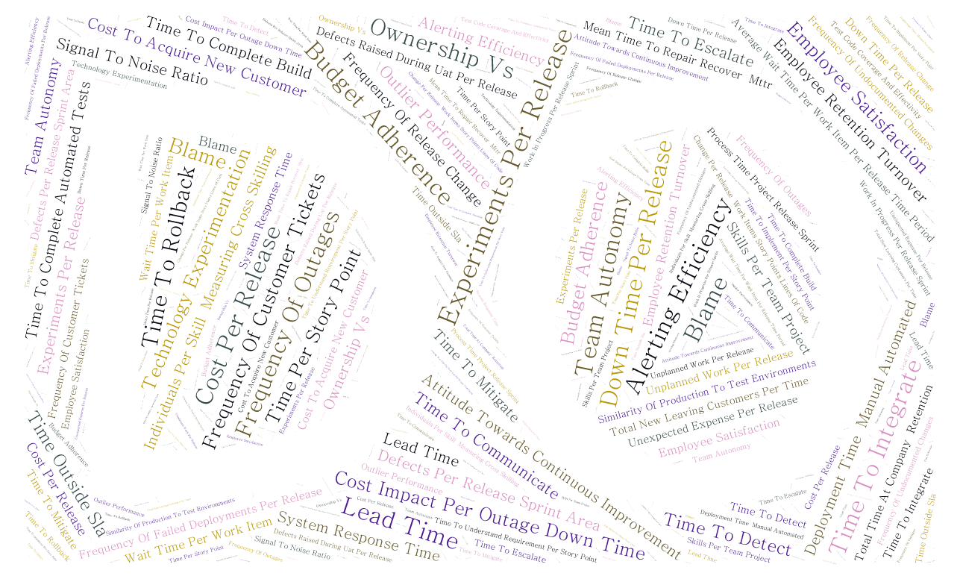
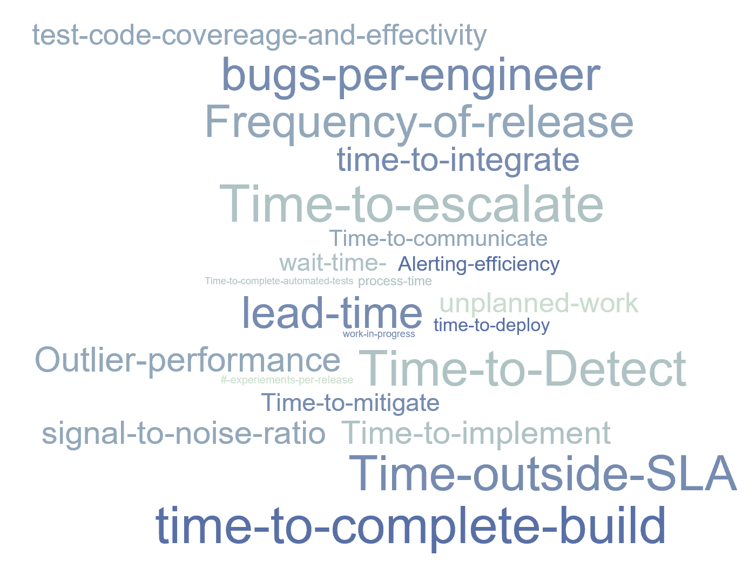
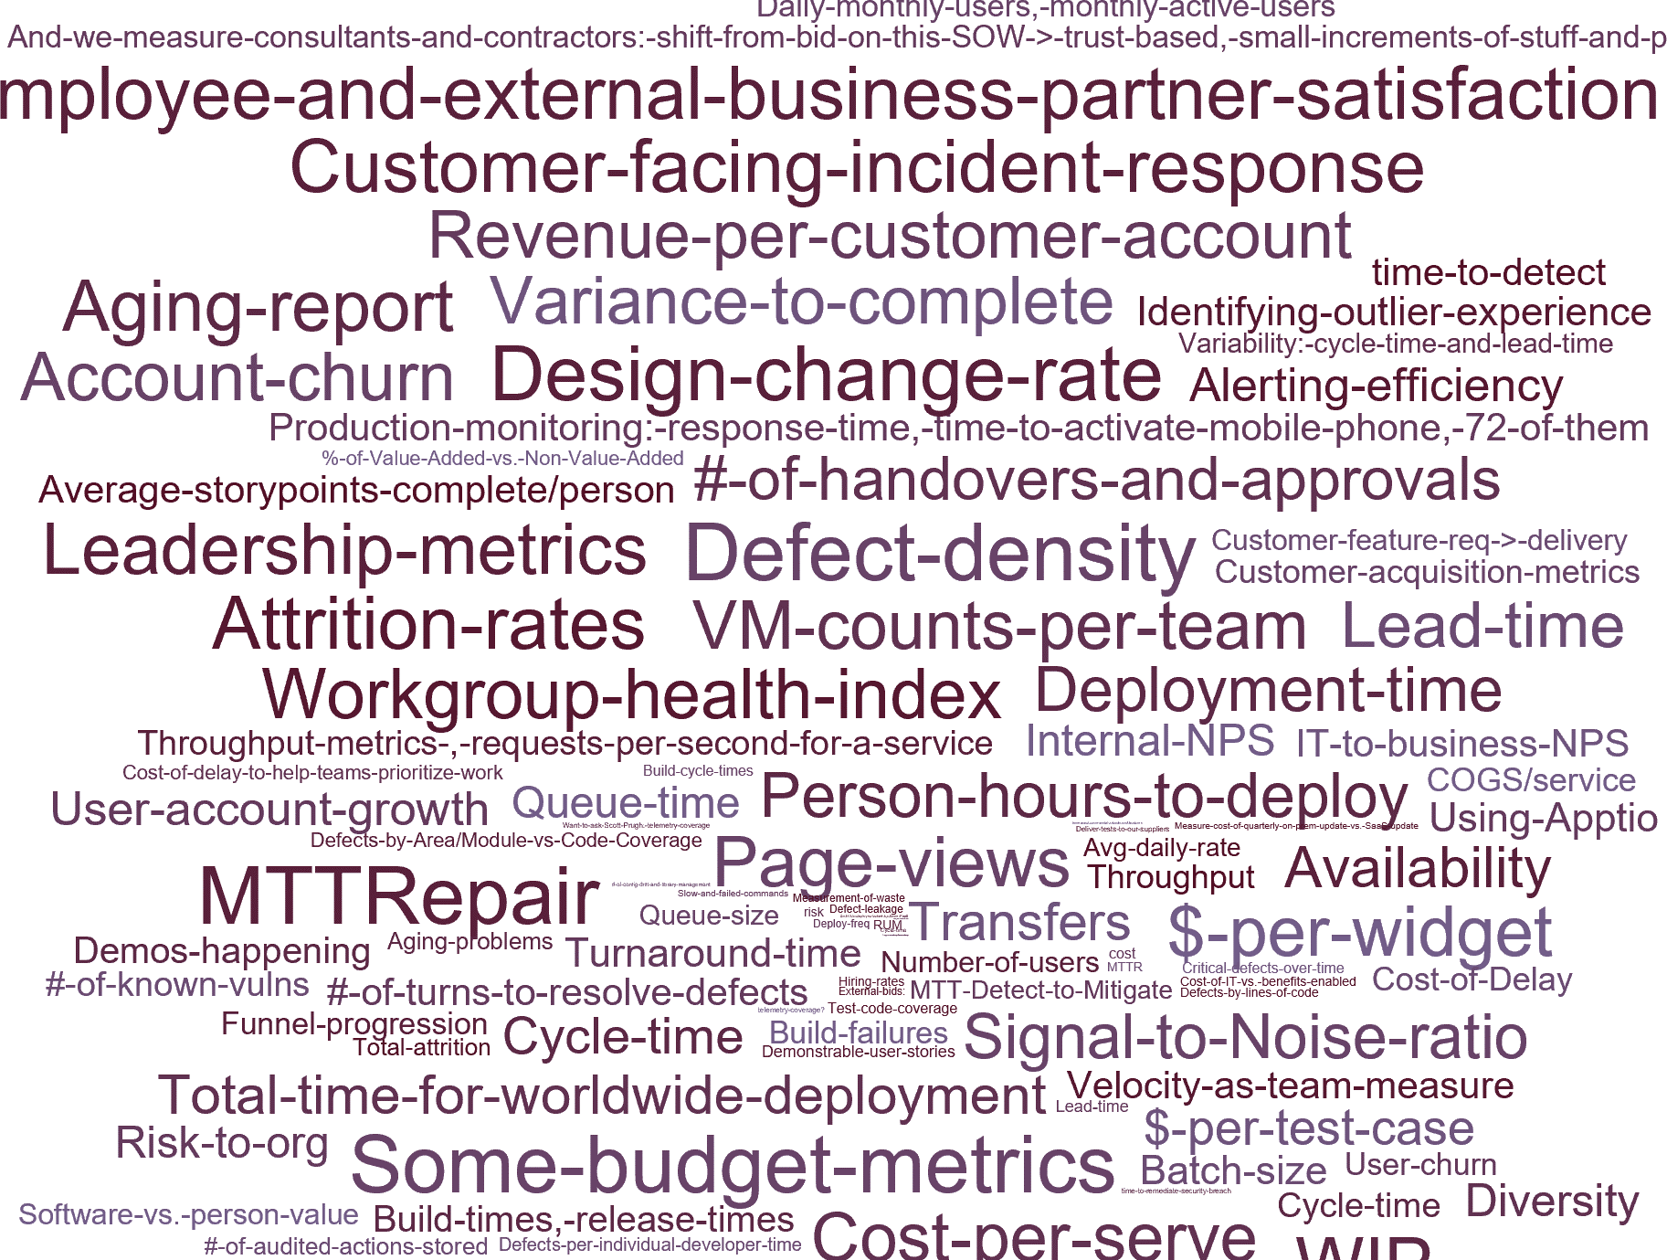
A Myriad of Choices
List see Itl.tc/DevOpsMetrics

Slide 9
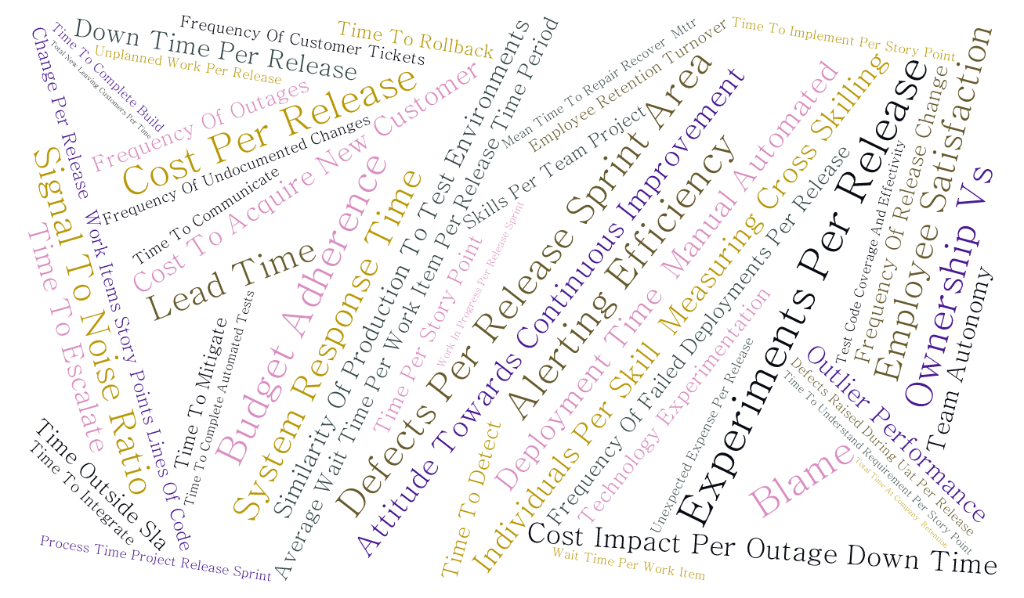
A Myriad of Choices

Slide 10
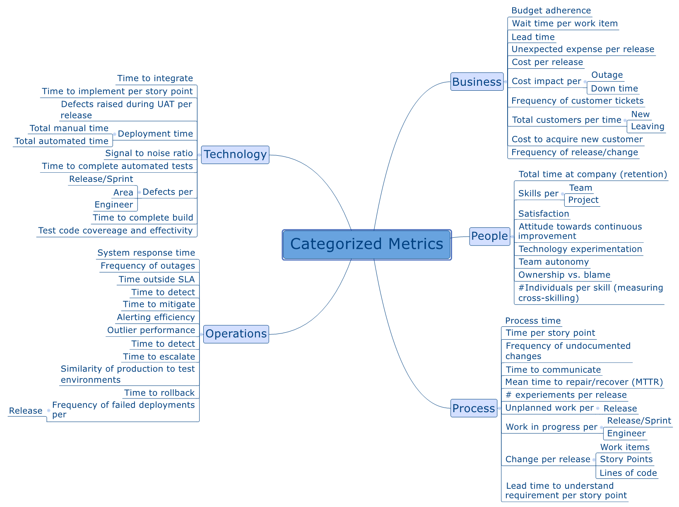
A Categorization of choices

Slide 11
Category Dimensions
CXO
HR
Operations
Business
R&D
Process
People
Operations
Business
Technology
Development
Cultural
Operations
Business
Process
People
Operations
Business
Technology
Discovery & Requirements Analysis
Development & Test
Integration/UAT
Deployment
Production

Slide 12
Lead Time = Process Time + Wait Time
Lead Time (LT):
Process Time (PT):
Wait Time (WT):
The elapsed time from receiving a customer request to delivering on that request.
Process time begins when the work has been pulled into a doing state and ends when the work is delivered to the next downstream customer.
The time that work sits idle not being worked.

Slide 13






A Organization Based Myriad of Choices
CXO
Budget adherence, wait time per work item per release/time-period, Lead time, Unexpected expense per release, Cost per release, Frequency of customer tickets, Total new/leaving customers per time, Cost to acquire new customer, Frequency of release/change
Lead Time
Director/Manager
Text
Engineering (System/ Software/ Operations)
Text
Text
% Successful CI Builds
Scrum Master
Developer

Slide 14
A Lifecycle of Metrics that Mater
Defects raised during UAT per release, Time per story point, Lead time to understand requirement per story point, Time to integrate, Time to implement per story point, Process time, Time to complete build, # experiments per release, Test code coverage and effectivity, Defects per, Release/Sprint, Area, Engineer, Time to complete automated tests, Unplanned work per, Release, Change per release, Work items, Story Points, Lines of code, Work in progress per, Release/Sprint, Engineer
Frequency of failed deployments per, Release, Time to rollback, Similarity of production to test environments, Time to escalate, Time to detect, Cost impact per, Outage, Down time, Outlier performance, Alerting efficiency, Time to mitigate, Time to detect, Time outside SLA, Frequency of outages, System response time
DevOps metric importance may be relative to lifecycle stage
Total automated time, Total manual time, Deployment time, Total manual time, Total automated time, Frequency of failed deployments per
Release, Time to rollback, Similarity of production to test environments
Time to detect, time to discover/describe work item, time to validate, time to identify acceptance criteria
Time to integrate, defects raised during UAT,
Discovery & Requirements Analysis
Research & Development
Integration/UAT
Deployment
Production
Lead time, Unexpected expense per release, wait time per work items, Average wait time per work item per release/time-period, Unexpected expense per release, cost per release, frequency of customer tickets, total customers per time, cost to acquire customer, frequency of release/change, Employee retention/turnover, Skills per team/project, Satisfaction, Attitude towards continuous improvement, Technology experimentation, Team autonomy, Ownership vs. blame, #Individuals per skill (measuring cross-skilling)

Slide 15
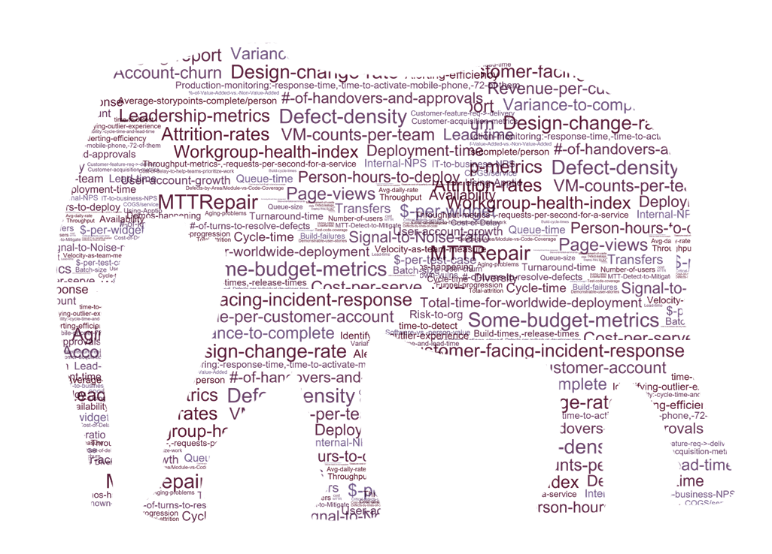



Perspective
Cost of new customer acquisition is more expensive than average profit per customer
Total customers are increasing

Slide 16
Principles of Measurement
Relevant
Automated
Transparent
Examined
Comparative
Don’t create cost for stuff that isn’t relevant
Automate measurement where possible, removing subjectivity and overhead
Use metrics as a driver for creating excellence
Don’t’ look in the mirror and ignore what you see (Learn)
Metrics are relevant with respect to a trend (its not the raw numbers).

Slide 17
Measure Efficiency, Effectiveness and Culture to Optimize DevOps Transformations White Paper
Itl.tc/DevOpsMetricsWP
Notes:
Interesting in how to succeed, come talk with us

Slide 18
Scenarios In Metrics Whitepaper
Moving to a Software-As-Service culture
Seven habits of effective DevOps
Dealing with high incident volumes
Measuring signal/noise ratio is the single best measure
Reducing complexity for integration environments
Simplification and modernization, the only two paths to reducing technical debt
Notes:
Measurements and metrics are very important, yet we often face unexpected challenges

Slide 19
Contributors
Chivas Nambiar, Director DevOps Platform Engineering, Verizon
Dominica DeGrandis, Director, Learning & Development, LeanKit
Eric Passmore, CTO MSN, Microsoft
Gene Kim, co-author of upcoming "DevOps Cookbook“
Jeff Weber, Managing Director, Protiviti
Mark Michaelis, Chief Technical Architect, IntelliTect
Mirco Hering, DevOps Lead APAC, Accenture
Nicole Forsgren, PhD, Director Organizational Performance & Analytics, Chef
Sam Guckenheimer, Product Owner, Visual Studio Cloud Services, Microsoft
Walker Royce, Software Economist
You?
Notes:
Thanks to our great list of contributors

Slide 20
Takeaways
Create predictability
Focus your strategy
Transparent metrics trend towards excellence
Are different for each team/person/organization
Metrics
Must be comparative

Slide 21
Thank you for your time.
Questions?

Slide 22




About Us
Mark Michaelis |
Chief Technical Architect, Author, Trainer
Mark@IntelliTect.com
fb.com/Mark.Michaelis
@MarkMichaelis

Slide 23

Clients

